Slide 1
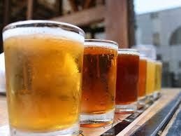
BUDWEISER PRESENTS: THE ULTIMATE IN MODERN BEERS
In a world where unwinding is more important than ever, there is a driven need for the perfect beer.
Introducing the utmost in luxury beers:
Q-TINE
Designed to make the most of natural flavor, with a soaring ABV and a low IBU, this really is a beer that can truly unwind you.

Slide 2
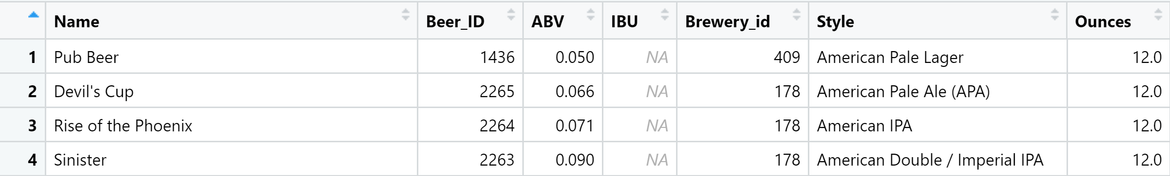
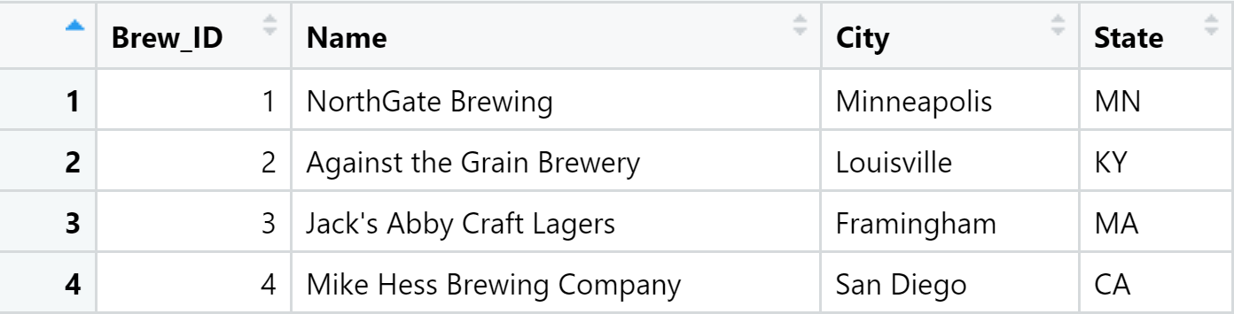
Discovery
Brewery Present by State
Beers.csv Sample
Missing Values
Given the two datasets shown, the Beers dataset
contained 2,410 US craft beers and Breweries dataset contained 558 US breweries. An exploratory data analysis was performed to find the perfect beer.
Median ABV & IBU By State
Breweries.csv Sample
Maximum ABV & IBU By State
Summary Statistics & Distribution of ABV
IBU vs ABV Relationship

Slide 3
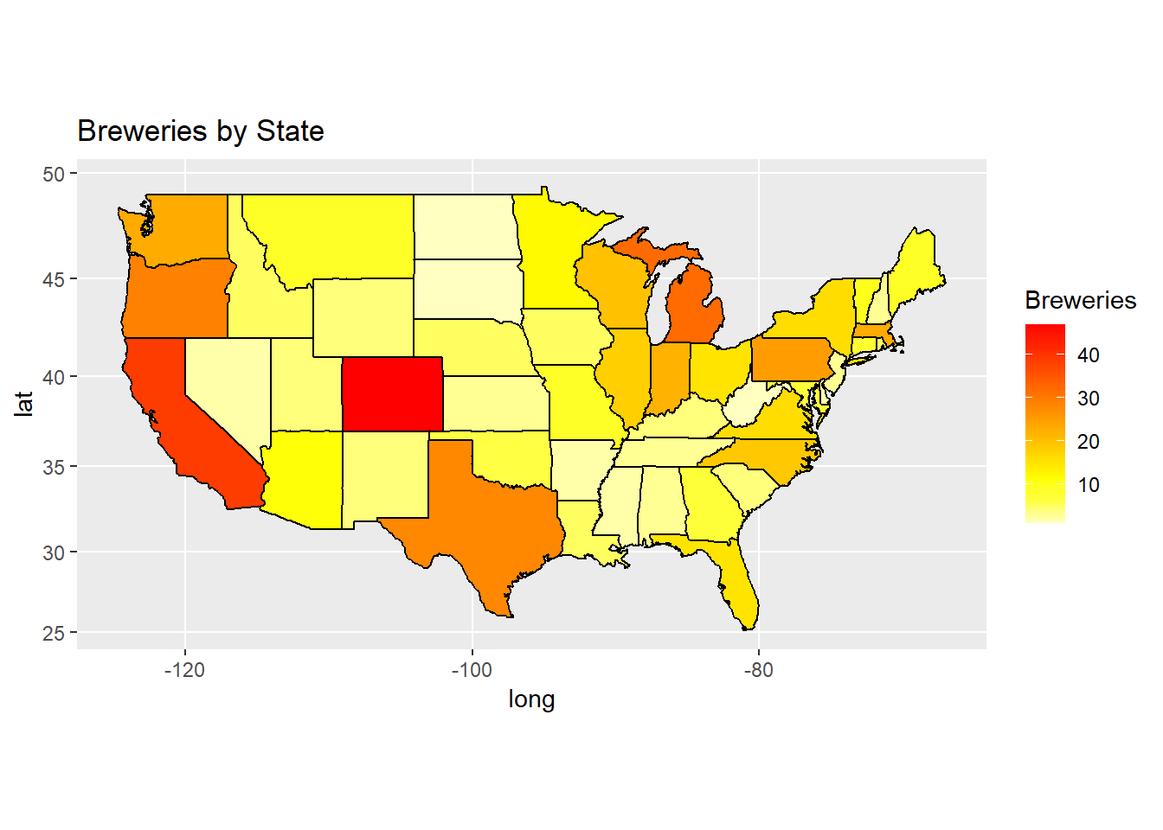

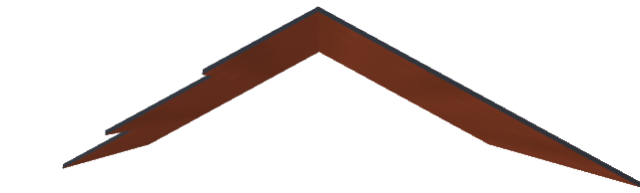
Brewery Present By State
Roof
Most of the U.S. breweries tend to be centered in California and Colorado.
States with the fewest breweries are North Dakota, South Dakota, and West Virginia
Note: Washington DC was removed because it is not a state.
3rd Floor

Slide 4
Missing Values
A total of 1,005 beers do not have recorded IBU values in the dataset
“IBUs are really interesting, but for the most part, we try not to emphasize them too much in anything consumer-facing. It’s not really relevant to your enjoyment of the product (…) Stone uses IBUs as an important quality control too, like most breweries, and while the consumer certainly wants to see it, we’re not making new beers to hit a certain IBU threshold.”
--Steve Gonzalez, senior manager of Small Batch Brewing & Innovation at Stone Brewing Company
A total of 62 beers do not have recorded ABV values in the dataset
In 1935, Congress banned the list of alcohol content to avoid "brew strength" wars between competitors.
In 1995, Coors Brewing Company won in a unanimous Supreme Court case which resulted in increased Freedom of Speech Amendment for commercial speech
-- Rubin vs. Coors Brewing Co. 514 U.S.476 (1995)
IBU
ABV
Notes:
IBU quote from https://www.craftbeer.com/craft-beer-muses/beer-ibus-fact-fiction-misconceptions
ABV court case

Slide 5
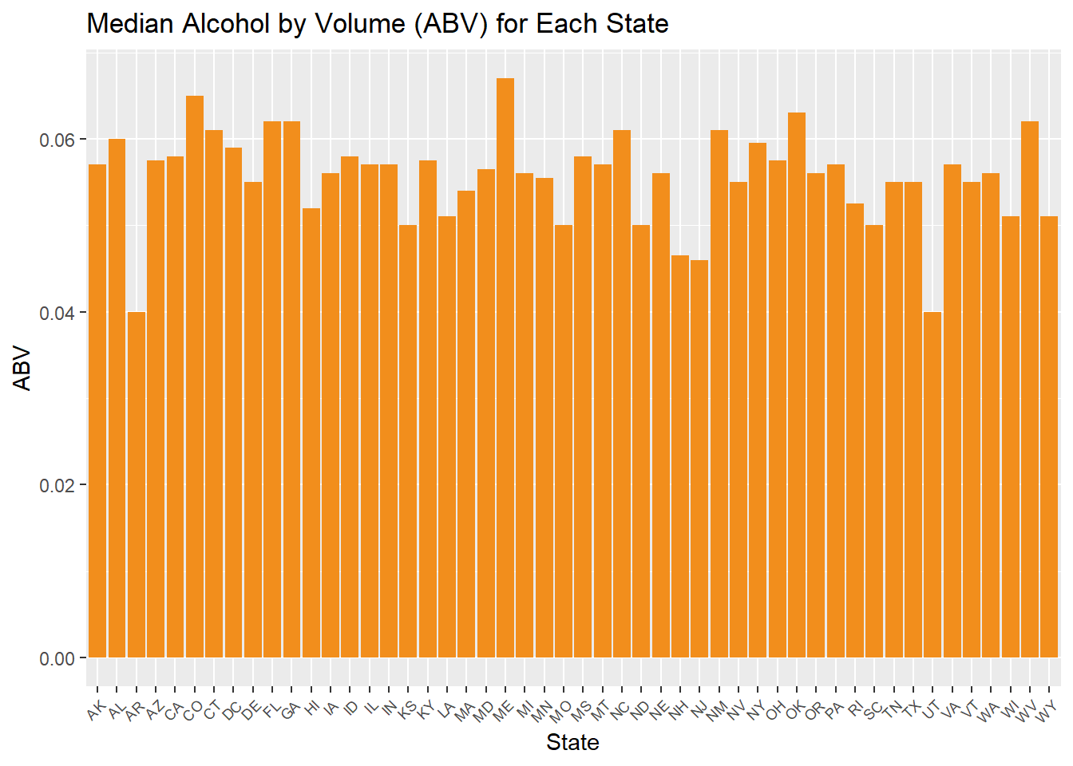
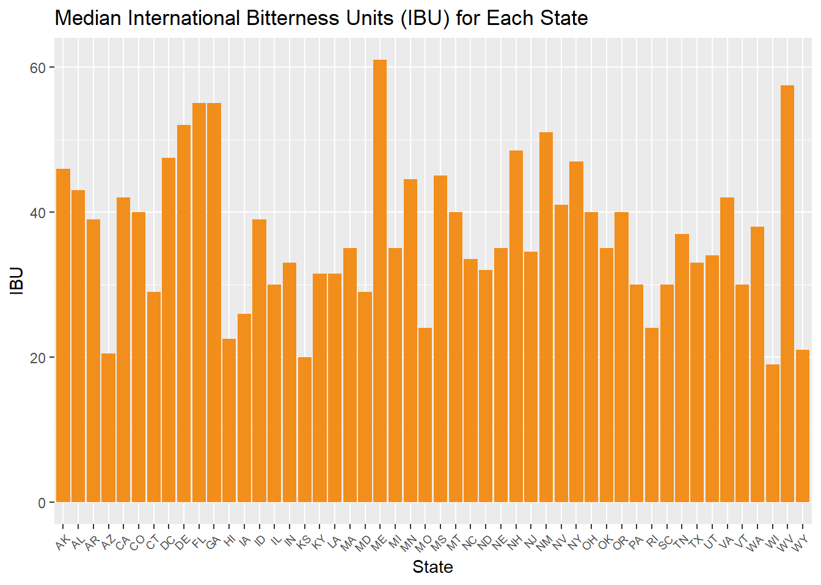
Median ABV & IBU By State
Median ABV By State
Median IBU By State

Slide 6
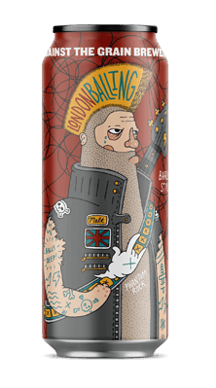
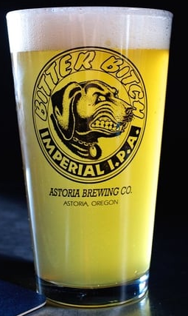
Maximum ABV & IBU By State
From Louisville, Kentucky,
Against the Grain Brewery's
Presents
Longdon Balling
With a smashing 12.5% ABV!
From Astoria, Oregon,
Astoria Brewing Company's
Presents
Bitter Bitch Imperial IPA
With a whopping IBU of 138!
Maximum ABV By State
Maximum IBU By State

Slide 7
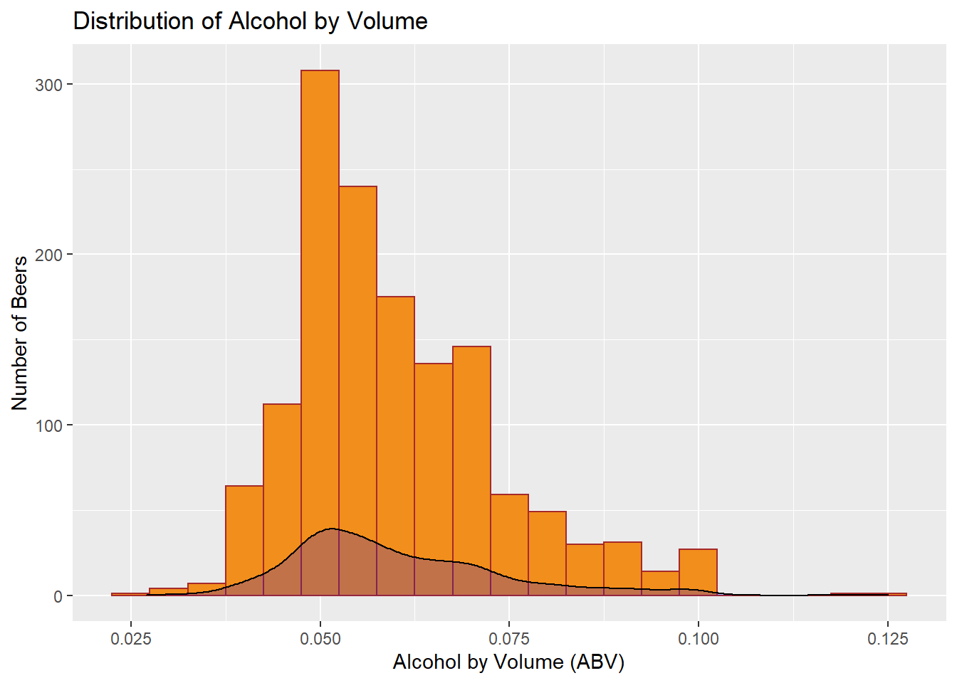
Summary Statistics & Distribution of ABV
Roof
Most beers ABV are centered at a little over 5%
75% of Beers recorded are at or below 6.8% ABV
Maximum ABV is 12.5% while minimum ABV is 2.7%
3rd Floor

Slide 8
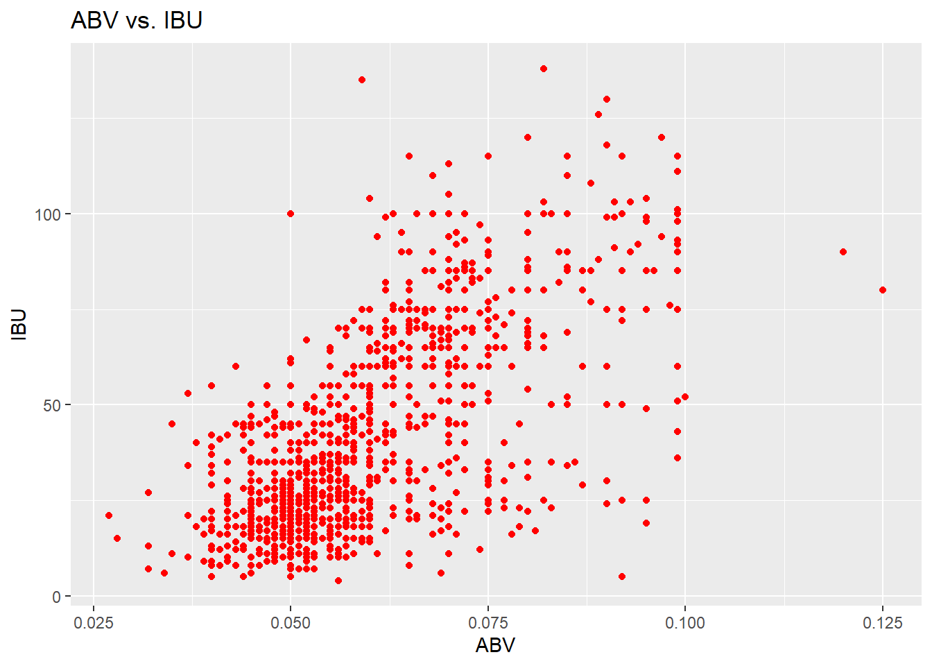
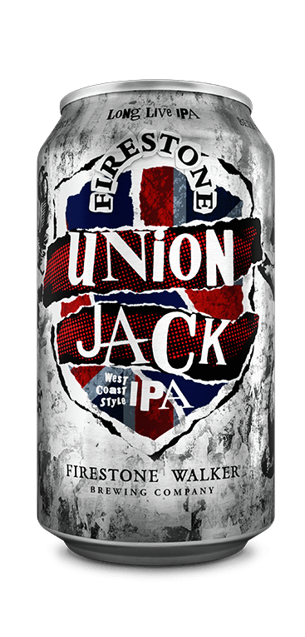
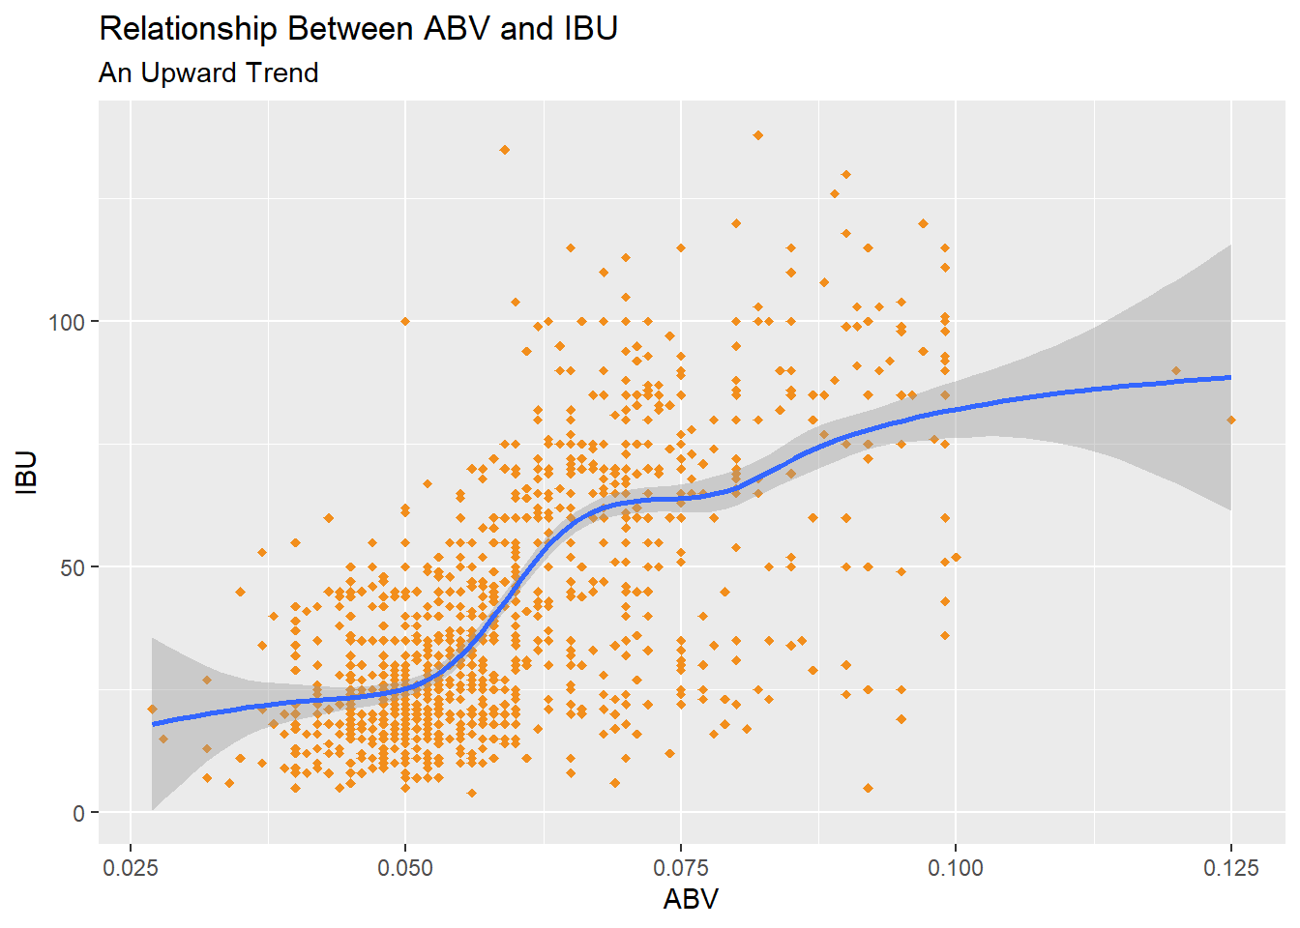
IBU vs ABV Relationship
Analysis
The linear relationship demonstrates that the higher an ABV, the greater the IBU and bitterness of the beer is.
Additionally, a greater number of beers tend to be around 5% ABV and IBU of 20 to 25
Suggestion
To receive the perfect balance of ABV and IBU, it is suggested that you choose a beer with a ABV of 7.5% and IBU of 75 such as Union Jack.
Notes:
Union Jack is produced by Firestone Walker Brewing Company in Paso Robles, California. It is a balanced American IPA that should leave you tingling from the alcohol and bitterness!

